Slide 1
ADLIN GRACIA RAJATHI
Final Project
3/21/2024 Annual Review
1

Slide 2
COOKIE STEGANOGRAPHY

Slide 3

AGENDA
Problem Statement
Proposed Solution
System Development Approach
Algorithm & Deployment
Result
Conclusion
Future Scope
References

Slide 4

Problem Statement
Cookies, while essential for website functionality, often contain sensitive user data. This data is vulnerable to inspection by third parties, raising privacy concerns. Develop a cookie steganography technique that effectively hides user data within cookies while maintaining functionality and remaining undetectable to casual inspection.

Slide 5
Proposed Solution
Message Preprocessing:
Content Analysis: Analyze the message content to assess its size and complexity. This will help determine the most suitable embedding technique and optimize utilization of cookie space.
Compression (Optional): For lengthy messages or cookie size limitations, consider using techniques like Run-Length Encoding (RLE) or Huffman Coding to reduce message size without compromising information integrity.
Embedding Algorithm:
LSB Insertion: Modify Least Significant Bits (LSBs) in existing cookie data fields (e.g., timestamps, session IDs) to embed message bits.
Procedural Steganography: Manipulate seemingly random elements within cookie generation (e.g., adding specific patterns to expiration times) to embed additional message data.
Stego-Cookie Construction:
Functionality Preservation: Ensure the stego-cookie remains functionally valid for the intended website or platform. Thoroughly test compatibility across different browsers and platforms.
Cover Generation (Optional): If modifying existing cookie data is not feasible, consider creating new stego-cookies containing both the message and seemingly innocuous data to avoid raising suspicion.
Security Considerations:
Steganalysis Resistance: Analyze the vulnerability of the chosen embedding algorithms to steganalysis techniques (statistical analysis, structural analysis, etc.). Refine the method or incorporate additional steganographic layers if necessary.

Slide 6
WHO ARE THE END USERS?
Privacy Advocates: Individuals concerned about online privacy might use cookie steganography to hide sensitive information within cookies, making it harder for third parties to track their online activities.
Security Researchers: Researchers studying security vulnerabilities or developing security tools might use cookie steganography to test and demonstrate potential weaknesses in web applications' cookie handling mechanisms.
Whistleblowers: Individuals sharing sensitive information or documents online might use cookie steganography to conceal data within innocuous-looking cookies, making it more difficult for adversaries to detect or intercept the information.
Journalists: Journalists working on investigative pieces or handling sensitive sources might employ cookie steganography to securely exchange information while minimizing the risk of interception or surveillance.
Digital Rights Activists: Activists advocating for digital rights and freedoms might use cookie steganography as part of their efforts to protect online communications and circumvent cens

Slide 7

System Approach
The Cookie steganography has minimal system requirements and can run on most modern computers. Here's a breakdown:
Software:
Python 3 (or compatible version) - The code is written in Python and requires a Python interpreter to be installed. Python is freely available for most operating systems.
base64 library (usually included) - The code utilizes the base64 library, which is typically included in the standard Python installation.
Hardware:
No specific hardware requirements - This code doesn't perform computationally intensive tasks and can run on any computer capable of running Python.

Slide 8
Algorithm & Deployment
Data Encoding:
Prepares the data for embedding by converting it to a suitable format and breaking it into manageable chunks.
Uses LSB insertion to modify the least significant bits of cookie values to represent the data bits.
Ensures modifications are subtle to avoid detection.
Data Decoding:
Extracts the encoded data from the cookie values by retrieving the least significant bits.
Reassembles the extracted bits back into the original data format.
Verifies the data integrity for any errors or missing parts.
Security Measures:
Emphasizes the importance of encryption to protect the hidden data before embedding.
Highlights the use of secure communication protocols (HTTPS) for secure transmission.
Mentions authentication mechanisms to control access to the decoded data.
Integration:
Suggests integrating the algorithm into web applications or browser extensions for user convenience.
Putting the system live on the hosting platform with proper DNS configuration and SSL/TLS certificates.

Slide 9
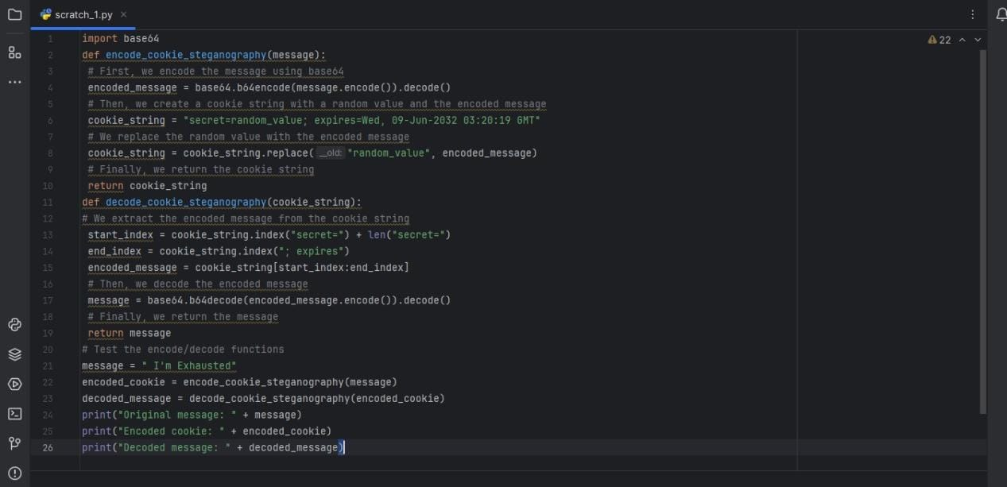
MODELLING

Slide 10
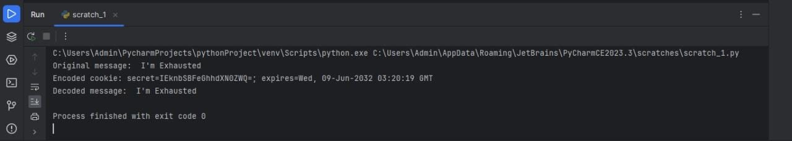
Result
Cookie steganography hides messages in plain sight, like secret codes in website cookies. These messages are encoded and hidden within cookies that store things like login information or preferences. A special program can decode the cookie to reveal the hidden message. While it can be a fun trick, there are more secure methods for transmitting confidential information.

Slide 11

Conclusion
Cookie steganography hides messages within cookies, offering a potential tool for covert communication. It leverages existing web technology but faces limitations. Cookie size restricts message capacity, and advanced techniques can detect hidden data. Ethical concerns arise from potential misuse. Browser compatibility adds complexity. While valuable in specific scenarios, cookie steganography isn't foolproof. Security through robust algorithms and encryption is crucial. Responsible use and awareness of legal implications are paramount. As steganalysis evolves, continuous adaptation is necessary. Cookie steganography provides a glimpse into covert communication, but careful evaluation is a must.

Slide 12
Future scope
The future of cookie steganography lies in continuous development, focusing on security, robustness, and responsible use. By addressing its limitations and exploring synergies with emerging technologies, it can become a valuable tool for secure communication in various scenarios.
Enhanced Security:
Advanced Steganographic Techniques: Research and incorporate more sophisticated embedding methods that are less susceptible to steganalysis. Explore techniques like adaptive steganography that dynamically adjust embedding based on the cover data (cookie) characteristics.
Improved Capacity and Robustness:
Steganalysis-aware Embedding: Develop embedding algorithms that take into account potential steganalysis techniques and adjust accordingly to minimize detection.
Hybrid Steganography: Combine cookie steganography with other covert communication channels for redundancy and increased capacity.
Emerging Technologies:
Integration with Blockchain: Explore ways to leverage blockchain technology for secure message exchange and tamper-proof verification. This could offer a more secure communication layer for steganographic techniques.
Quantum-Resistant Steganography: As quantum computing advances, develop techniques resistant to potential quantum-based steganalysis methods..

Slide 13
References
Katzenbeisser, S., & Petitcolas, F. A. P. (2000). Information Hiding Techniques for Steganography and Digital Watermarking. Artech House Publishers.
Ramani, A., & Gandhi, M. N. (2012). A Secure Approach to Hide Information in Cookies Using Steganography. International Journal of Engineering Research and Applications, 2(4), 2157-2162.
Sivakumar, R., & Thilagavathy, K. (2011). Secure data transmission using HTTP cookies with steganography. International Journal of Computer Applications, 21(3), 26-32.
Westfeld, A., & Pfitzmann, A. (1999). Attacks on Steganographic Systems. In Information Hiding (pp. 61-76). Springer.
Ye, X., & Wu, Q. (2007). A Novel Steganography Scheme for Cookies. In International Conference on Computational Intelligence and Security (pp. 795-798). Springer.
Kravets, D., & Shaffer, C. (2004). Privacy-enhanced web browsing using HTTP cookies. ACM Transactions on Internet Technology (TOIT), 4(2), 171-194.
Wright, C. V., Ballard, L., Coull, S., & Monrose, F. (2009). Spot me if you can: Uncovering spoken phrases in encrypted VoIP conversations. Proceedings of the 16th ACM conference on Computer and communications security.

Slide 14
THANK YOU

